Slide 1


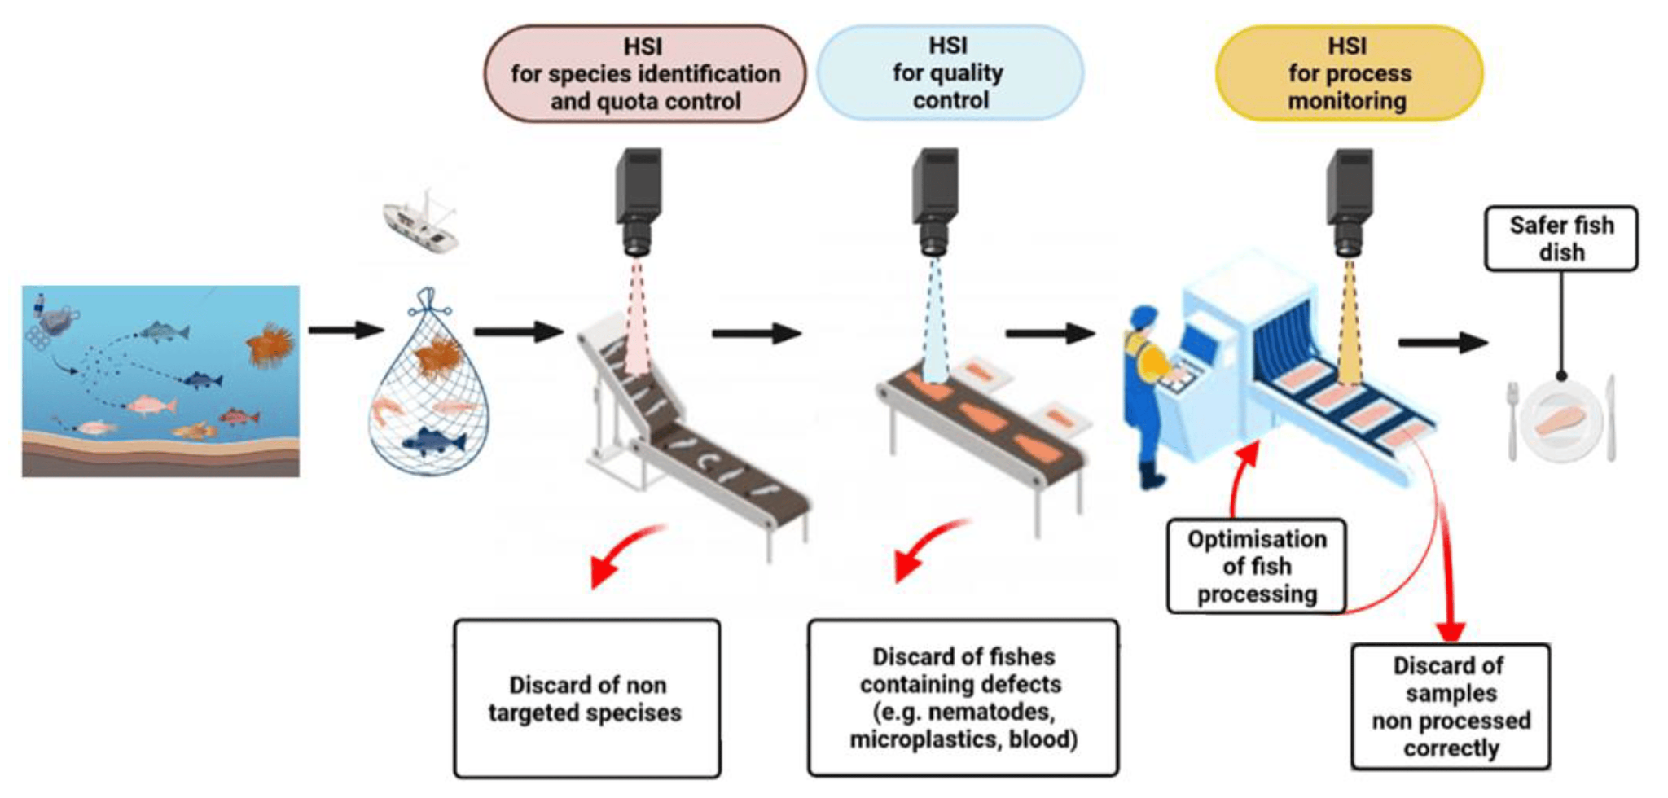
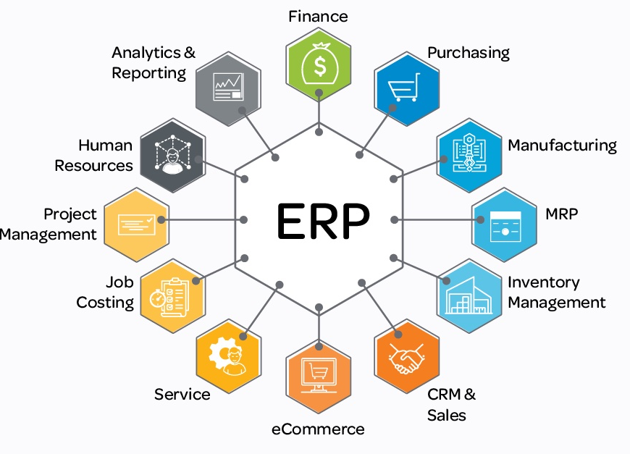
Da Yang Seafood
Software Engineer Internship
Presenter: Eugene Hung Advisor: Dr. Arkady Retik Sponsor: Da Yang Seafood, Inc.
BACKGROUND
ARCHITECTURE
SKILL LEARNED
Utilize OpenCV and TensorFlow in a deeper level, and how it actually performs on a physical sensor.
How to develop database model using real-life scenarios and methods of understanding the process.
Communication between supervisors, colleagues, and representatives of other departments.
Other specialties in the fishing industry.
Da Yang is a fishery, processing, and distribution company. I worked on multiple software engineering projects that touched upon various aspects of the company's operations. My primary focus was on three key areas: Enterprise Resource Planning (ERP) system development, object recognition technology for fish processing, and Point of Sale (POS) system development.
GOAL
FUTURE WORK
Da Yang is opening several new departments and implementing new technologies. My goal is to assist the company have a good foundation for future developments.
Work as a full-time software engineer at Da Yang Seafood.
Continue the ongoing projects.
Help integrate the whole ERP system for new departments.
Understand and develop technology used on ships.
METHODOLOGY
Acknowledgements
Understand the flow of fish processing by working physically on the line and have several meetings with the factory manager.
Conduct research on the topics needed.
Develop ERP system model and program using MySQL
Test and integrate object recognition sensors using OpenCV and Tensorflow.
RESULTS
Dr. Retik: Thank you for being my capstone advisor and provide assistance throughout the process.
Da Yang Seafood: Thanks to the company that gives me an internship and return offer.
ERP: The model and program are operational and will be reviewed and modified by supervisors.
Object Recognition: The collected and organized data will be used for future development of the object recognition technology.

